Slide 1
CSE-304 Design & Analysis of Algorithm
Asymptotic Notation II
and Recurrence Relation

Slide 2
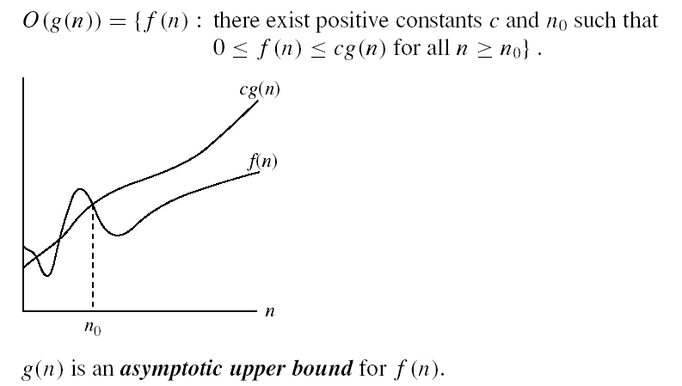
Asymptotic notations
O-notation
Intuitively: O(g(n)) = the set of functions with a smaller or same order of growth as g(n)

Slide 3
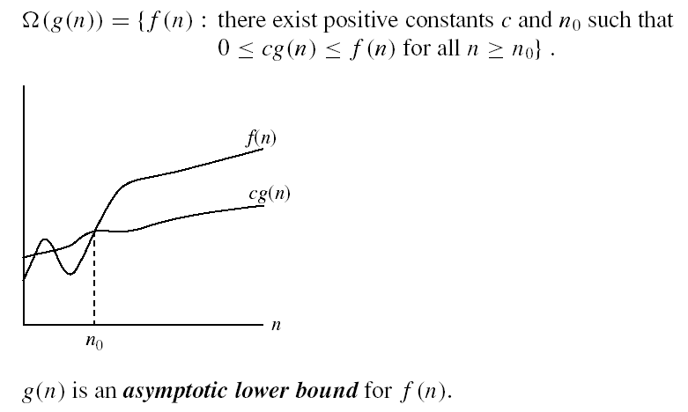
Asymptotic notations (cont.)
Ω - notation
Intuitively: Ω(g(n)) = the set of functions with a larger or same order of growth as g(n)

Slide 4

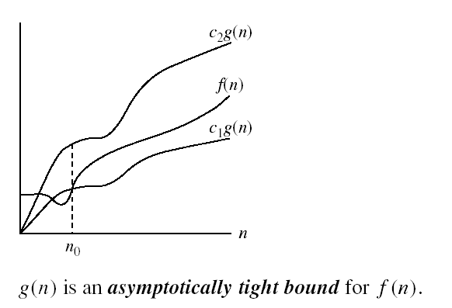
Asymptotic notations (cont.)
Θ-notation
Intuitively Θ(g(n)) = the set of functions with the same order of growth as g(n)

Slide 5
Exercise on O-notation
Show that 3n²+2n+5 = O(n²)
10 n² = 3n² + 2n² + 5n²
≥ 3n² + 2n + 5 for n ≥ 1
c = 10, n₀ = 1

Slide 6
Exercise on O-notation
O(n²)
O(n log n)
O(n²)
O(n log n)
f1(n) = 10 n + 25 n²
f2(n) = 20 n log n + 5 n
f3(n) = 12 n log n + 0.05 n²
f4(n) = n^{1/2} + 3 n log n
Notes:
For each function, find the simplest and g(n) such that f_i(n) = O(g(n))

Slide 7
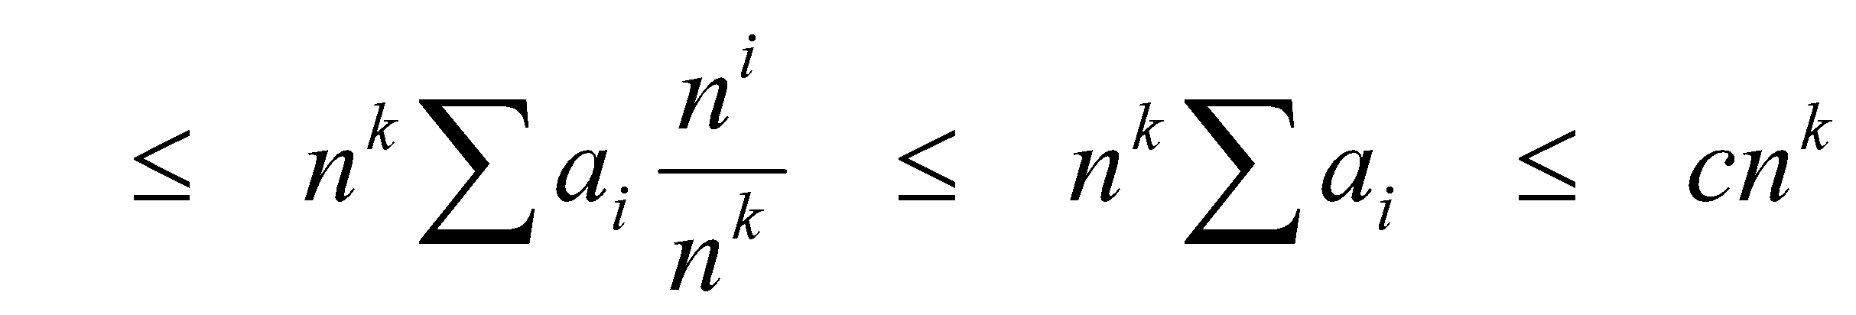
Big O Fact
A polynomial of degree k is O(n^{k})
Proof:
Suppose f(n) = b_{k}n^{k} + b_{k-1}n^{k-1} + … + b₁n + b₀
Let a_{i} = | b_{i} |
f(n) ≤ a_{k}n^{k} + a_{k-1}n^{k-1} + … + a₁n + a₀

Slide 8
Comparisons of Functions
Transitivity:
f(n) = Θ(g(n)) and g(n) = Θ(h(n)) ⇒ f(n) = Θ(h(n))
Same for O and Ω
Reflexivity:
f(n) = Θ(f(n))
Same for O and Ω
Symmetry:
f(n) = Θ(g(n)) if and only if g(n) = Θ(f(n))
Transpose symmetry:
f(n) = O(g(n)) if and only if g(n) = Ω(f(n))

Slide 9
Simplifying Assumptions
1. If f(n) = O(g(n)) and g(n) = O(h(n)), then f(n) = O(h(n))
2. If f(n) = O(kg(n)) for any k > 0, then f(n) = O(g(n))
3. If f₁(n) = O(g₁(n)) and f₂(n) = O(g₂(n)),
then f₁(n) + f₂(n) = O(max (g₁(n), g₂(n)))
4. If f₁(n) = O(g₁(n)) and f₂(n) = O(g₂(n)),
then f₁(n) * f₂(n) = O(g₁(n) * g₂(n))
‹#›
Notes:
‹#›

Slide 10
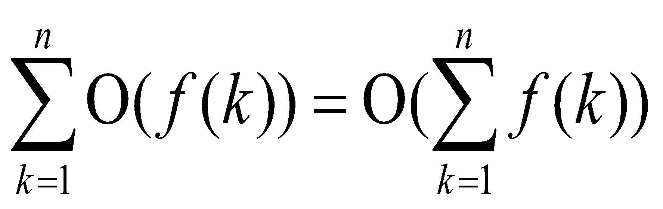
Manipulating Asymptotic Notation
cO(f(n)) = O(f(n))
O(O(f(n))) = O(f(n))
O(f(n))O(g(n)) = O(f(n)g(n))
O(f(n)g(n)) = f(n)O(g(n))
O(f(n)+g(n)) = ( max ( f(n),g(n))

Slide 11
More Examples
(a) 0.5n² - 5n + 2 = Ω( n²).
Let c = 0.25 and n₀ = 25.
0.5 n² - 5n + 2 = 0.25( n²) for all n = 25
(b) 0.5 n² - 5n + 2 = O( n²).
Let c = 0.5 and n₀ = 1.
0.5( n²) = 0.5 n² - 5n + 2 for all n = 1
(c) 0.5 n² - 5n + 2 = Θ( n²)
from (a) and (b) above.
Use n₀ = 25, c₁ = 0.25, c₂ = 0.5 in the definition.

Slide 12
GENERAL RULES FOR ANALYSIS(1/5)
1. Consecutive statements
Maximum statement is the one counted
e.g. a fragment with single for-loop followed by double for- loop is O(n²).
Block #1
t₁
t₁+t₂ = max(t₁,t₂)
Block #2
t₂

Slide 13
GENERAL RULES FOR ANALYSIS(2/5)
2. If/Else
if cond then S1
else
S2
Block #1
t₁
Block #2
t₂
Max(t₁,t₂)

Slide 14
GENERAL RULES FOR ANALYSIS(3/5)
3. For Loops
Running time of a for-loop is at most the running time of the statements inside the for-loop times number of iterations
for (i = sum = 0; i < n; i++)
sum += a[i];
for loop iterates n times, executes 2 assignment statements each iteration ==> asymptotic complexity of O(n)

Slide 15
GENERAL RULES FOR ANALYSIS(4/5)
4. Nested For-Loops
Analyze inside-out. Total running time is running time of the statement multiplied by product of the sizes of all the for-loops
e.g. for (i =0; i < n; i++)
for (j = 0, sum = a[0]; j <= i ; j++)
sum += a[j];
printf("sum for subarray - through %d is %d\n", i, sum);

Slide 16
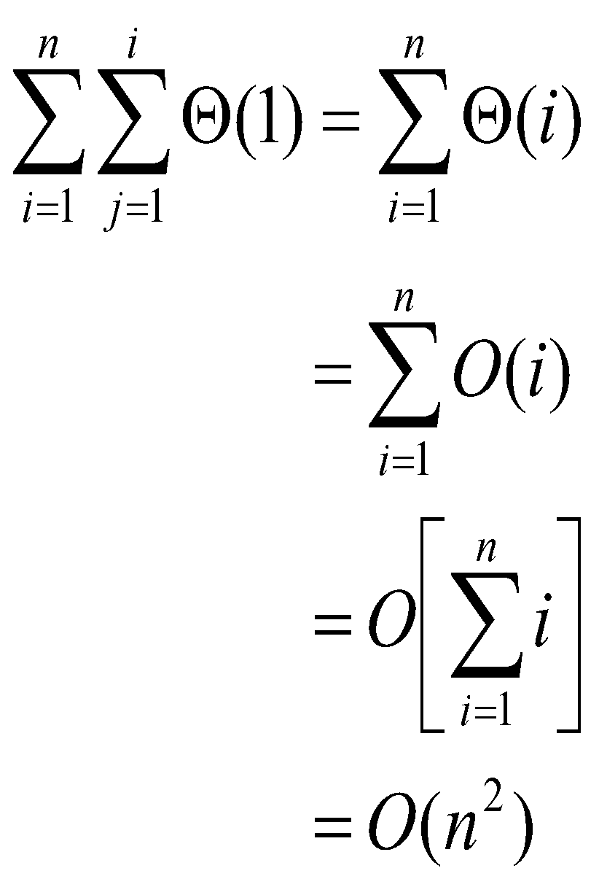
GENERAL RULES FOR ANALYSIS(5/5)

Slide 17
Recurrence Relations (1/2)
A recurrence relation is an equation which is defined in terms of itself.
Why are recurrences good things?
Many natural functions are easily expressed as recurrences:
a_{n} = a _{n-1} + 1, a₁ = 1−−> a_{n} = n (polynomial)
a_{n} = 2a _{n-1} ,a₁ = 1−−> a_{n} = 2^{n} (exponential)
a_{n} = na _{n-1} ,a₁ = 1−−> a_{n} = n! (weird function)
It is often easy to find a recurrence as the solution of a counting problem

Slide 18
Recurrence Relations (2/2)
In both, we have general and boundary conditions, with the general condition breaking the problem into smaller and smaller pieces.
The initial or boundary condition terminate the recursion.

Slide 19
Recurrence Equations
A recurrence equation defines a function, say T(n). The function is defined recursively, that is, the function T(.) appear in its definition. (recall recursive function call). The recurrence equation should has a base case.
For example:
T(n) = T(n-1)+T(n-2), if n>1
1, if n=1 or n=0.
base case
for convenient, we sometime write the recurrence equation as:
T(n) = T(n-1)+T(n-2)
T(0) = T(1) = 1.

Slide 20
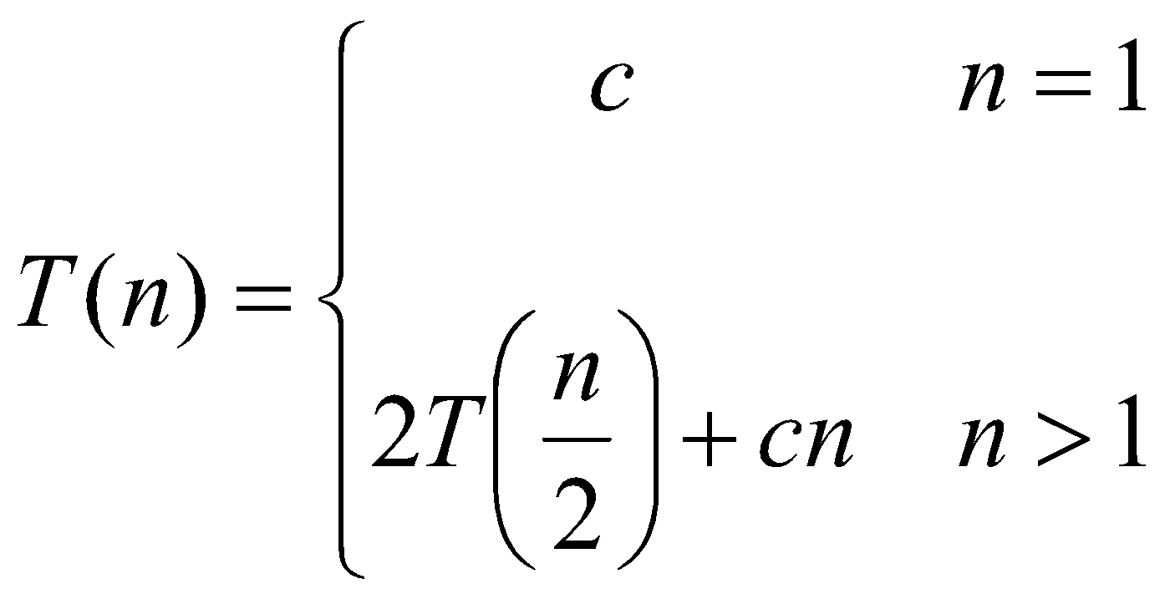
Recurrences
The expression:
is a recurrence.
Recurrence: an equation that describes a function in terms of its value on smaller functions

Slide 21
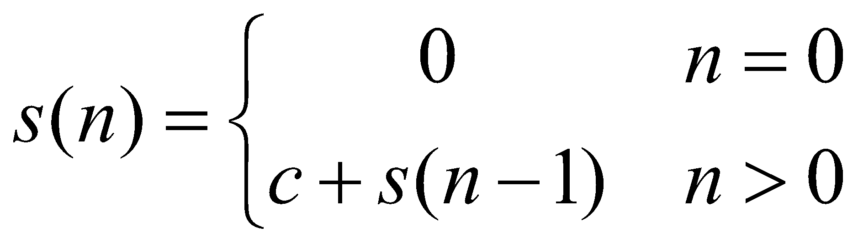
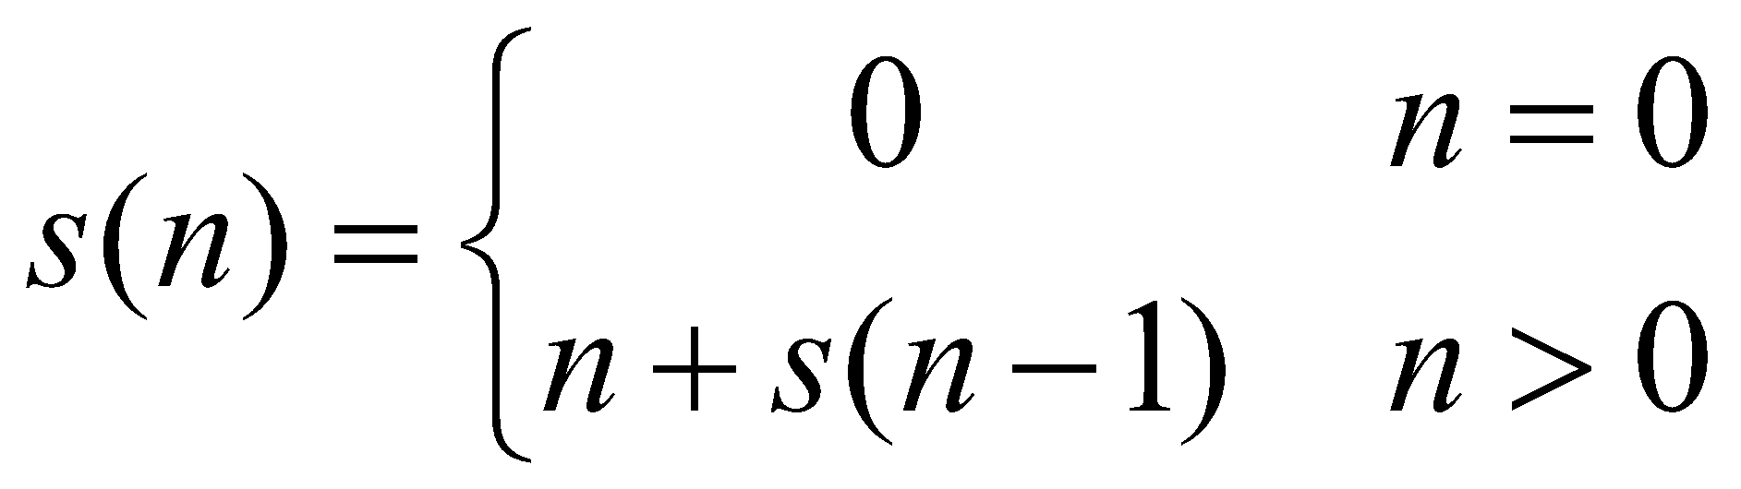
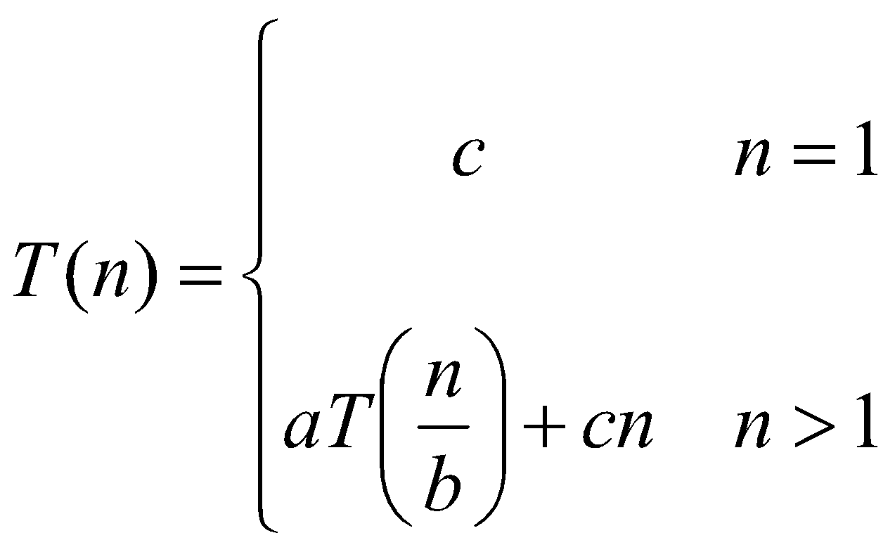
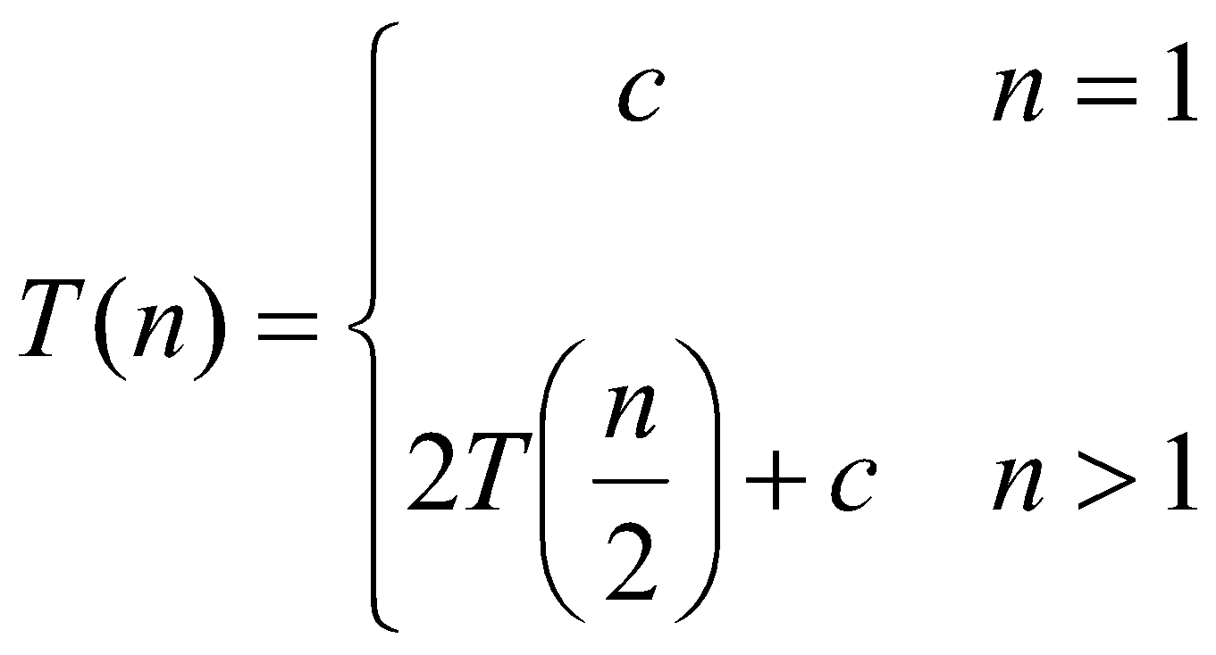
Recurrence Examples

Slide 22
More Recurrence equations:
T(n) = 2 * T(n/2) + 1,
T(1) = 1.
Base case;
initial condition.
T(n) = T(n-1) + n,
T(1) = 1.
Selection Sort
T(n) = 2* T(n/2) + n,
T(1) = 1.
Merge Sort
Quick Sort
T(n) = 2*T(n/2) + log n,
T(1) = 1.
Heap Construction
T(n) = T(n/2) + 1,
T(1) = 0.
Binary search

Slide 23
Methods for Solving Recurrences
Iteration method
Substitution method
Recursion tree method
Master method
‹#›

Slide 24
Simplications:
There are two simplications we apply that won't affect asymptotic analysis
ignore floors and ceilings (justification in text)
assume base cases are constant, i.e., T(n) = Θ(1) for n small enough

Slide 25
Solving Recurrences: Iteration (convert to summation)
Expand the recurrence
Work some algebra to express as a summation
Evaluate the summation

Slide 26
The Iteration Method
T(n) = c + T(n/2)
T(n) = c + T(n/2)
= c + c + T(n/4)
= c + c + c + T(n/8)
Assume n = 2^{k}
T(n) = c + c + … + c + T(1)
= clgn + T(1)
= Θ(lgn)
T(n/2) = c + T(n/4)
T(n/4) = c + T(n/8)
k times
‹#›

Slide 27
s(n) =
c + s(n-1)
c + c + s(n-2)
2c + s(n-2)
2c + c + s(n-3)
3c + s(n-3)
…
kc + s(n-k) = ck + s(n-k)

Slide 28
So far for n >= k we have
s(n) = ck + s(n-k)
What if k = n?
s(n) = cn + s(0) = cn

Slide 29
So far for n >= k we have
s(n) = ck + s(n-k)
What if k = n?
s(n) = cn + s(0) = cn
So
Thus in general
s(n) = cn

Slide 30
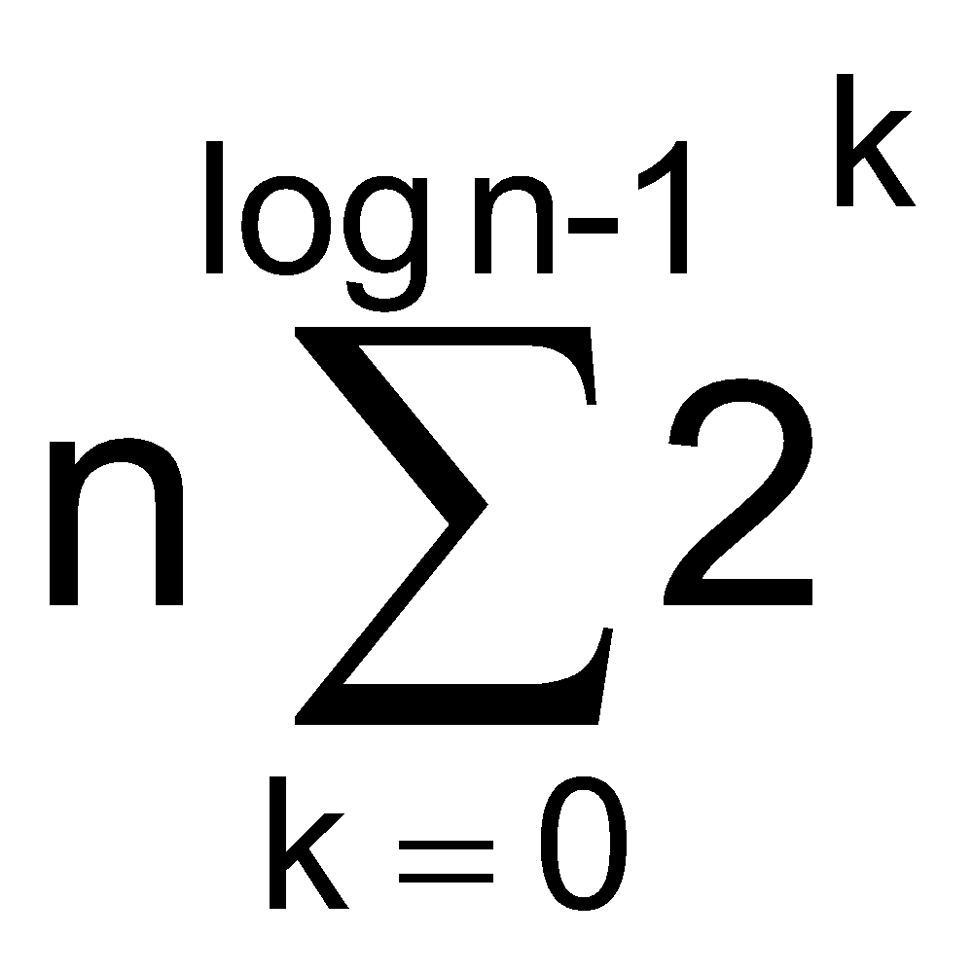
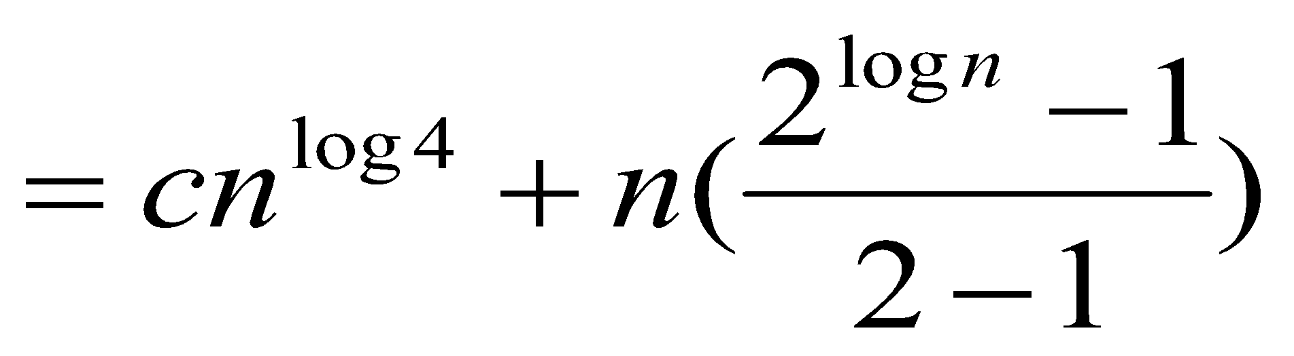
Solving Recurrences: Iteration (convert to summation)
Example: T(n) = 4T(n/2) + n
T(n) = 4T(n/2) + n /**expand**/
= 4(n/2 + 4T(n/4)) + n /**simplify**/
= 16T(n/4) + 2n + n /**expand**/
= 16(n/4 + 4T(n/8)) + 2n + n /**simplify**/
= 4^{log n} T(1)+ … + 4n + 2n + n /** #levels = log n **/
= c4^{log n} + /** convert to summation**/
/** a^{log b} = b^{log a} **/

Slide 31
Solving Recurrences: Iteration (convert to summation) (cont.)
= cn²+n(n^{log 2} -1) /** 2^{log n} = n^{log 2} **/
= cn² +n(n - 1)
= cn² +n² - n
= Θ(n²)

Slide 32
The substitution method
Guess a solution
Use induction to prove that the solution works
‹#›

Slide 33
Substitution method
Guess a solution
T(n) = O(g(n))
Induction goal: apply the definition of the asymptotic notation
T(n) ≤ d g(n), for some d > 0 and n ≥ n₀
Induction hypothesis: T(k) ≤ d g(k) for all k < n
Prove the induction goal
Use the induction hypothesis to find some values of the constants d and n₀ for which the induction goal holds
‹#›

Slide 34
Example: Binary Search
T(n) = c + T(n/2)
Guess: T(n) = O(lgn)
Induction goal: T(n) ≤ d lgn, for some d and n ≥ n₀
Induction hypothesis: T(n/2) ≤ d lg(n/2)
Proof of induction goal:
T(n) = T(n/2) + c ≤ d lg(n/2) + c
= d lgn – d + c ≤ d lgn
if: – d + c ≤ 0, d ≥ c
‹#›

Slide 35
Example 2
T(n) = T(n-1) + n
Guess: T(n) = O(n²)
Induction goal: T(n) ≤ c n², for some c and n ≥ n₀
Induction hypothesis: T(k-1) ≤ c(k-1)² for all k < n
Proof of induction goal:
T(n) = T(n-1) + n ≤ c (n-1)² + n
= cn² – (2cn – c - n) ≤ cn²
if: 2cn – c – n ≥ 0 ⇔ c ≥ n/(2n-1) ⇔ c ≥ 1/(2 – 1/n)
For n ≥ 1 ⇒ 2 – 1/n ≥ 1 ⇒ any c ≥ 1 will work
‹#›

Slide 36
Example 3
T(n) = 2T(n/2) + n
Guess: T(n) = O(nlgn)
Induction goal: T(n) ≤ cn lgn, for some c and n ≥ n₀
Induction hypothesis: T(n/2) ≤ cn/2 lg(n/2)
Proof of induction goal:
T(n) = 2T(n/2) + n ≤ 2c (n/2)lg(n/2) + n
= cn lgn – cn + n ≤ cn lgn
if: - cn + n ≤ 0 ⇒ c ≥ 1
‹#›

Slide 37
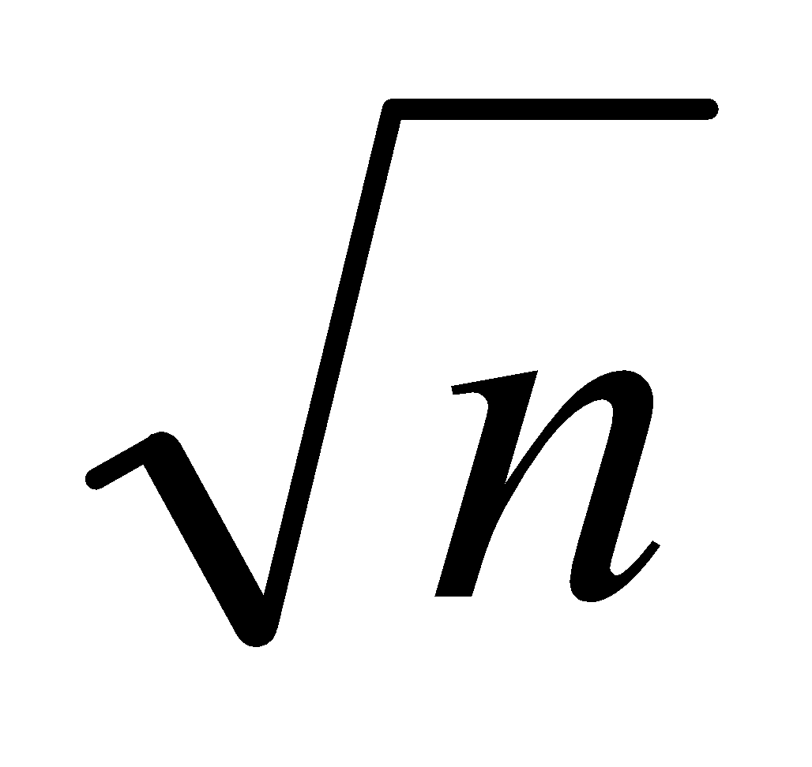
Changing variables
T(n) = 2T( ) + lgn
Rename: m = lgn ⇒ n = 2^{m}
T (2^{m}) = 2T(2^{m/2}) + m
Rename: S(m) = T(2^{m})
S(m) = 2S(m/2) + m ⇒ S(m) = O(mlgm) (demonstrated before)
T(n) = T(2^{m}) = S(m) = O(mlgm)=O(lgnlglgn)
Idea: transform the recurrence to one that you have seen before
‹#›

Slide 38
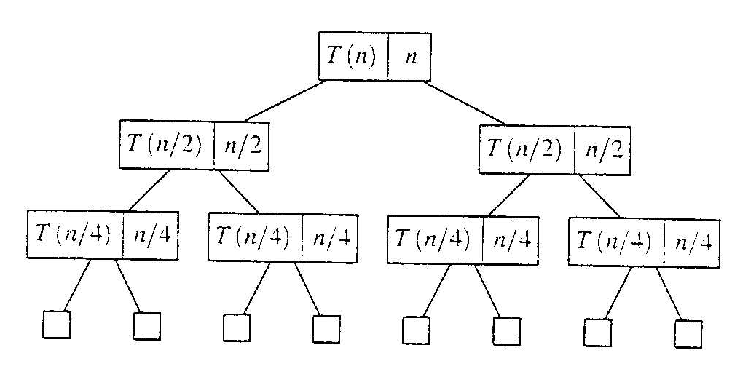
Evaluate recursive equation using Recursion Tree
Evaluate: T(n) = T(n/2) + T(n/2) + n
Work copy: T(k) = T(k/2) + T(k/2) + k
For k=n/2, T(n/2) = T(n/4) + T(n/4) + (n/2)
[size|cost]

Slide 39
Recursion-tree method
A recursion tree models the costs (time) of a recursive execution of an algorithm.
The recursion tree method is good for generating guesses for the substitution method.
The recursion-tree method can be unreliable.
The recursion-tree method promotes intuition, however.

Slide 40
Recursion Tree e.g.
To evaluate the total cost of the recursion tree
sum all the non-recursive costs of all nodes
= Sum (rowSum(cost of all nodes at the same depth))
Determine the maximum depth of the recursion tree:
For our example, at tree depth d the size parameter is n/(2^{d})
the size parameter converging to base case, i.e. case 1
such that, n/(2^{d}) = 1,
d = lg(n)
The rowSum for each row is n
Therefore, the total cost, T(n) = n lg(n)

Slide 41
Example of recursion tree
Solve T(n) = T(n/4) + T(n/2) + n²:

Slide 42
Example of recursion tree
Solve T(n) = T(n/4) + T(n/2) + n²:
T(n)

Slide 43
Example of recursion tree
Solve T(n) = T(n/4) + T(n/2) + n²:
n²
T(n/4)
T(n/2)

Slide 44
Example of recursion tree
Solve T(n) = T(n/4) + T(n/2) + n²:
n²
(n/4)²
(n/2)²
T(n/16)
T(n/8)
T(n/8)
T(n/4)

Slide 45
Example of recursion tree
Solve T(n) = T(n/4) + T(n/2) + n²:
n²
(n/4)²
(n/2)²
(n/16)²
(n/8)²
(n/8)²
(n/4)²
…
Θ(1)

Slide 46
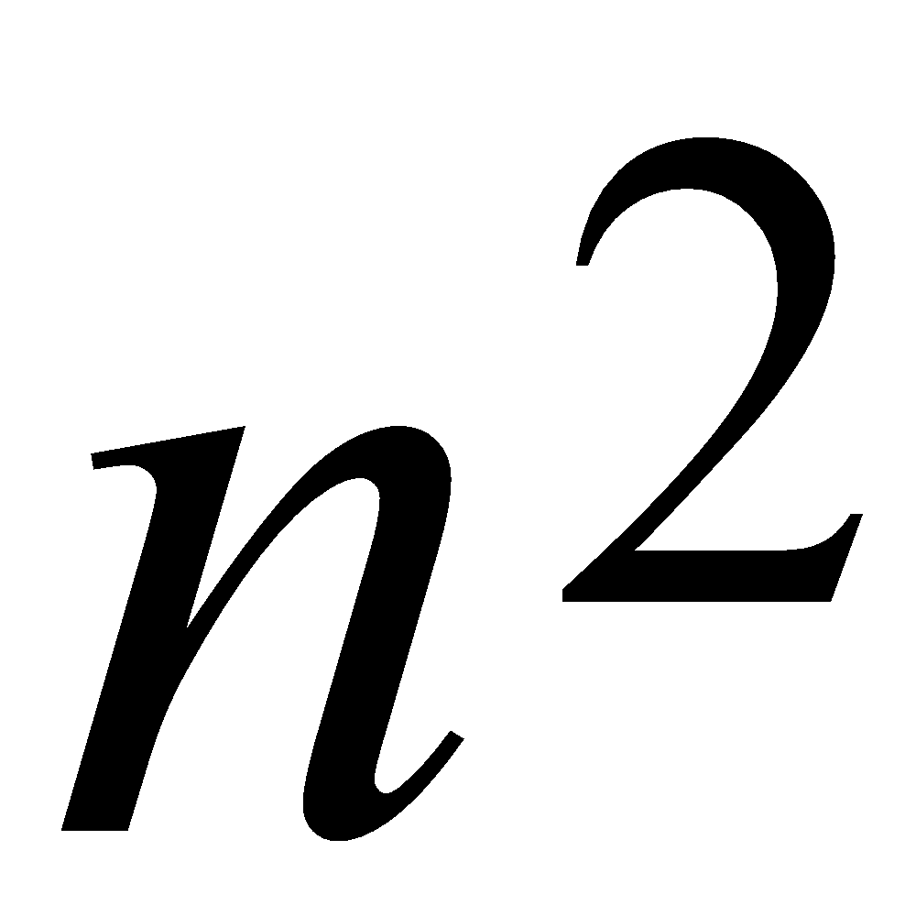
Example of recursion tree
Solve T(n) = T(n/4) + T(n/2) + n²:
n²
(n/4)²
(n/2)²
(n/16)²
(n/8)²
(n/8)²
(n/4)²
…
Θ(1)

Slide 47
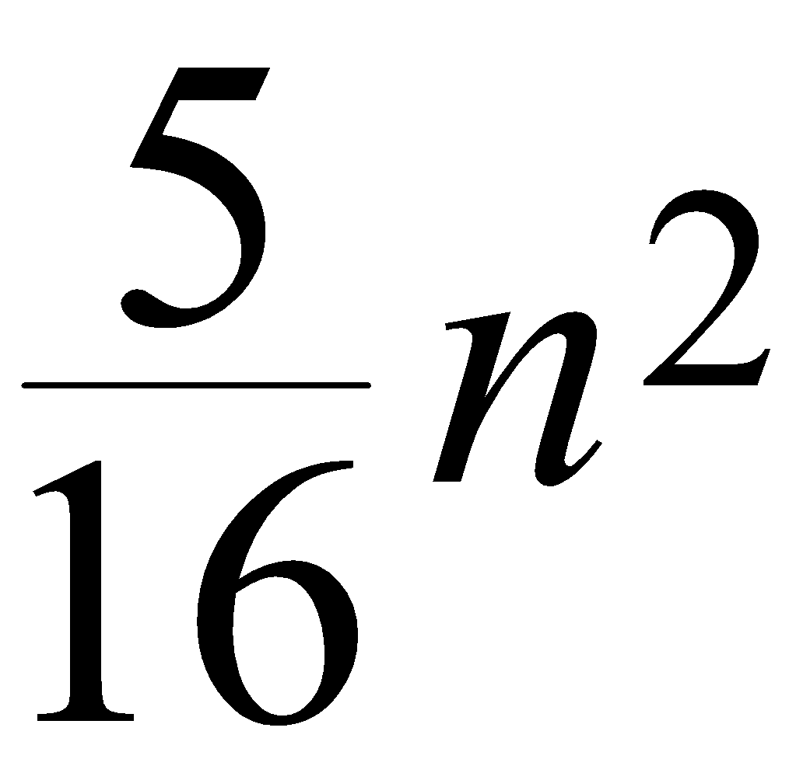
Example of recursion tree
Solve T(n) = T(n/4) + T(n/2) + n²:
n²
(n/4)²
(n/2)²
(n/16)²
(n/8)²
(n/8)²
(n/4)²
…
Θ(1)

Slide 48
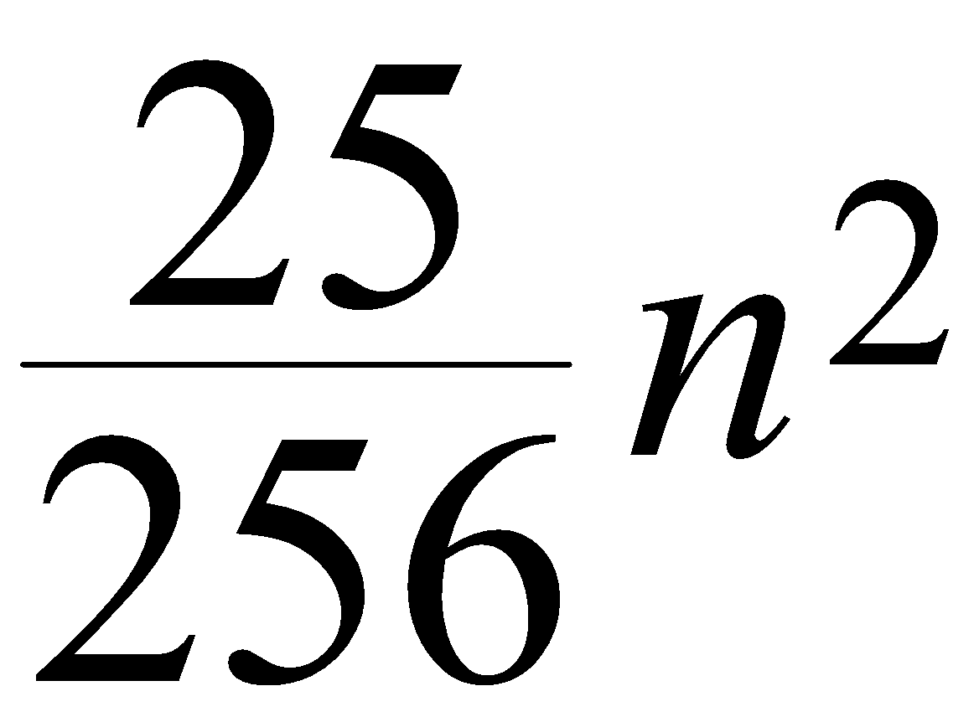
Example of recursion tree
Solve T(n) = T(n/4) + T(n/2) + n²:
n²
(n/4)²
(n/2)²
(n/16)²
(n/8)²
(n/8)²
(n/4)²
…
…
Θ(1)

Slide 49
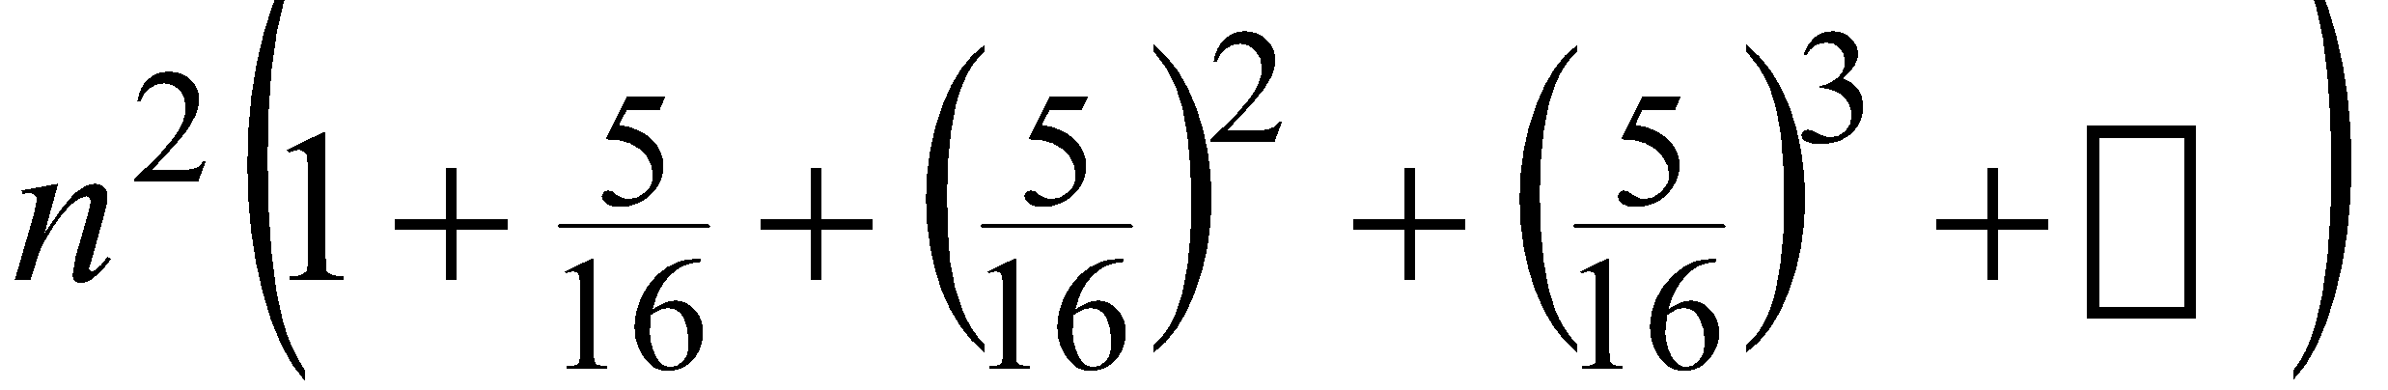
Example of recursion tree
Solve T(n) = T(n/4) + T(n/2) + n²:
n²
(n/4)²
(n/2)²
(n/16)²
(n/8)²
(n/8)²
(n/4)²
…
…
Θ(1)
Total =
= Θ(n²)
geometric series

